Slide 1
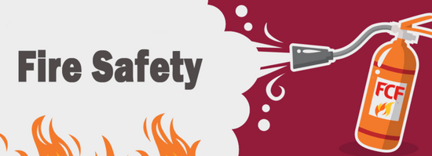
Fire and OHS occupational health and saftey
student : Marwan Bakr Mohamed
student no : 220212347
Class 2
Computer Engineering

Slide 2
Fire safety
Fire safety is the set of practices intended to reduce the destruction caused by fire. Fire safety measures include those that are intended to prevent the ignition of an uncontrolled fire and those that are used to limit the development and effects of a fire after it starts.
Fire safety measures include those that are planned during the construction of a building or implemented in structures that are already standing, and those that are taught to occupants of the building.
Threats to fire safety are commonly referred to as fire hazards. A fire hazard may include a situation that increases the likelihood of a fire or may impede escape in the event a fire occurs.
Fire safety is often a component of building safety. Those who inspect buildings for violations of the Fire Code and go into schools to educate children on fire safety topics are fire department members known as Fire Prevention Officers. The Chief Fire Prevention Officer or Chief of Fire Prevention will normally train newcomers to the Fire Prevention Division and may also conduct inspections or make presentations.

Slide 3
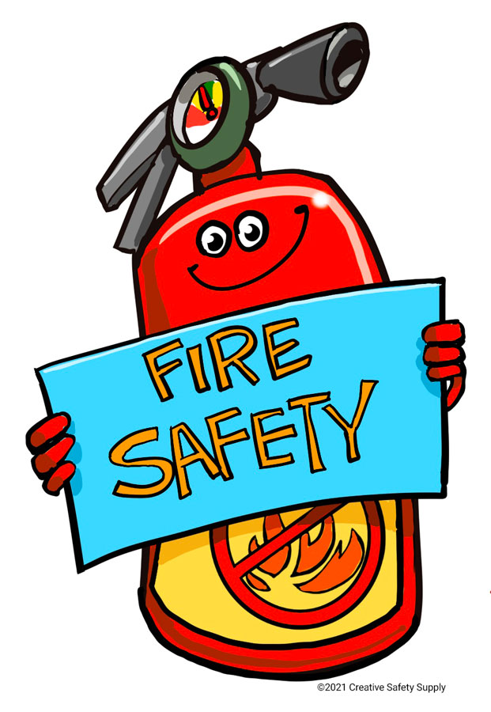
Fire and OHS
Over time we have learned fundamental fire safety principles for preventing fire events and managing their impact (i.e. the Common Principles: Prevention, Detection and Communication, Occupant Protection, Containment and Extinguishment) that can be consistently applied internationally , therefore now we are able to make fire saftey as a main base in occupational heath an saftey.

Slide 4
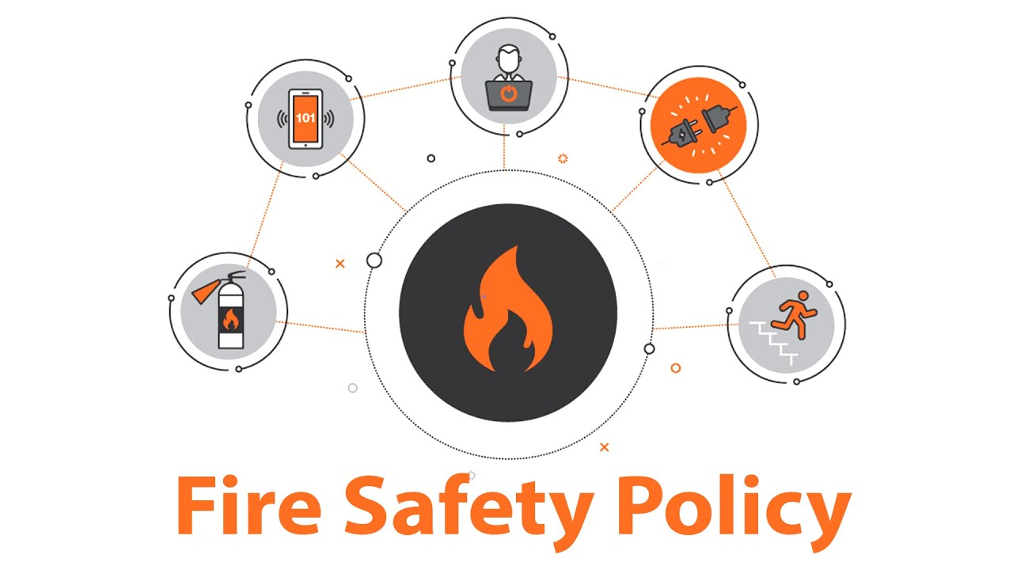
Elements of a fire safety policy
Fire safety policies apply at the construction of a building and throughout its operating life. Building codes are enacted by local, sub-national, or national governments to ensure such features as adequate fire exits, signage, and construction details such as fire stops and fire rated doors, windows, and walls. Fire safety is also an objective of electrical codes to prevent overheating of wiring or equipment, and to protect from ignition by electrical faults.
Fire codes regulate such requirements as the maximum occupancy for buildings such as theatres or restaurants, for example. Fire codes may require portable fire extinguishers within a building, or may require permanently installed fire detection and suppression equipment such as a fire sprinkler system and a fire alarm system.
Local authorities charged with fire safety may conduct regular inspections for such items as usable fire exit and proper exit signage, functional fire extinguishers of the correct type in accessible places, and proper storage and handling of flammable materials. Depending on local regulations, a fire inspection may result in a notice of required action, or closing of a building until it can be put into compliance with fire code requirements.
Owners and managers of a building may implement additional fire policies. For example, an industrial site may designate and train particular employees as a fire fighting force. Managers must ensure buildings comply with fire evacuation regulations, and that building features such as spray fireproofing remains undamaged. Fire policies may be in place to dictate training and awareness of occupants and users of the building to avoid obvious mistakes, such as the propping open of fire doors. Buildings, especially institutions such as schools, may conduct fire drills at regular intervals throughout the year.
Beyond individual buildings, other elements of fire safety policies may include technologies such as wood coatings, education and prevention, preparedness measures, wildfire detection and suppression, and ensuring geographic coverage of local and sufficient fire extinguishing capacities.

Slide 5
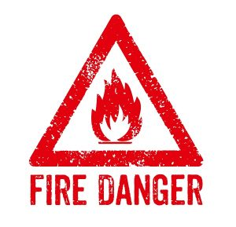
Common fire hazards
Some common fire hazards are:
Kitchen fires from unattended cooking, grease fires/chip pan fires
Electrical systems that are overloaded, poorly maintained or defective
Combustible storage areas with insufficient protection
Combustibles near equipment that generates heat, flame, or sparks
Candles and other open flames
Smoking (Cigarettes, cigars, pipes, lighters, etc.)
Equipment that generates heat and utilizes combustible materials
Flammable liquids and aerosols
Flammable solvents (and rags soaked with solvent) placed in enclosed trash cans
Fireplace chimneys not properly or regularly cleaned
Cooking appliances - stoves, ovens
Heating appliances - fireplaces, wood-burning stoves, furnaces, boilers, portable heaters, solid fuels
Household appliances - clothes dryers, curling irons, hair dryers, refrigerators, freezers, boilers
Chimneys that concentrate creosote
Electrical wiring in poor condition
Leaking/ defective batteries
Personal ignition sources - matches, lighters
Electronic and electrical equipment
Exterior cooking equipment - barbecuev

Slide 6
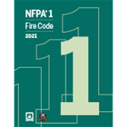
Fire code
In the United States, the fire code (also fire prevention code or fire safety code) is a model code adopted by the state or local jurisdiction and enforced by fire prevention officers within municipal fire departments. It is a set of rules prescribing minimum requirements to prevent fire and explosion hazards arising from storage, handling, or use of dangerous materials, or from other specific hazardous conditions.[6] It complements the building code. The fire code is aimed primarily at preventing fires, ensuring that necessary training and equipment will be on hand, and that the original design basis of the building, including the basic plan set out by the architect, is not compromised. The fire code also addresses inspection and maintenance requirements of various fire protection equipment in order to maintain optimal active fire protection and passive fire protection measures.
A typical fire safety code includes administrative sections about the rule-making and enforcement process, and substantive sections dealing with fire suppression equipment, particular hazards such as containers and transportation for combustible materials, and specific rules for hazardous occupancies, industrial processes, and exhibitions.
Sections may establish the requirements for obtaining permits and specific precautions required to remain in compliance with a permit. For example, a fireworks exhibition may require an application to be filed by a licensed pyrotechnician, providing the information necessary for the issuing authority to determine whether safety requirements can be met. Once a permit is issued, the same authority (or another delegated authority) may inspect the site and monitor safety during the exhibition, with the power to halt operations, when unapproved practices are seen or when unforeseen hazards arise.

Slide 7
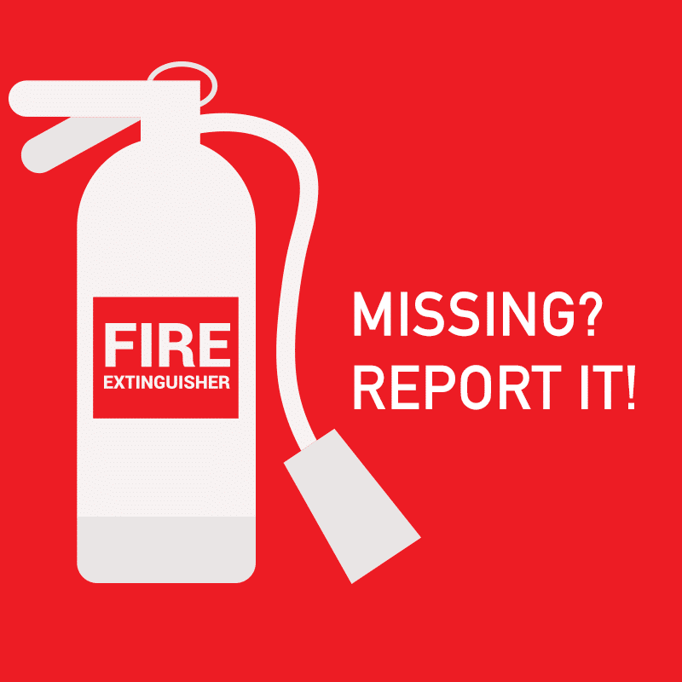
List of some typical fire and explosion issues in a fire code
Fireworks, explosives, mortars and cannons, model rockets (licenses for manufacture, storage, transportation, sale, use)
Certification for servicing, placement, and inspecting fire extinguishing equipment
General storage and handling of flammable liquids, solids, gases (tanks, personnel training, markings, equipment)
Limitations on locations and quantities of flammables (e.g., 10 liters of gasoline inside a residential dwelling)
Specific uses and specific flammables (e.g., dry cleaning, gasoline distribution, explosive dusts, pesticides, space heaters, plastics manufacturing)
Permits and limitations in various building occupancies (assembly hall, hospital, school, theater, elderly care, child care centers) that require a smoke detector, sprinkler system, fire extinguisher, or other specific equipment or procedures
Removal of interior and exterior obstructions to emergency exits or firefighters and removal of hazardous materials
Permits and limitations in special outdoor applications (tents, asphalt kettles, bonfires, etc.)
Other hazards (flammable decorations, welding, smoking, bulk matches, tire yards)
Electrical safety codes such as the National Electrical Code (by the National Fire Protection Association) for the U.S. and some other places in the Americas
Fuel gas code
Car fire

Slide 8

Public fire safety education
Children evacuating a smoky building as a way to learn fire safety
Members of the United States Forest Service Fire Department teaching children fire safety
Most U.S. fire departments have fire safety education programs.
Fire prevention programs may include distribution of smoke detectors, visiting schools to review key topics with the students and implementing nationally recognized programs such as NFPAS "Risk Watch" and "Learn not to burn".
Other programs or props can be purchased by fire departments or community organizations. These are usually entertaining and designed to capture children's attention and relay important messages. Props include those that are mostly auditory, such as puppets and robots. The prop is visually stimulating but the safety message is only transmitted orally. Other props are more elaborate, access more senses and increase the learning factor. They mix audio messages and visual cues with hands-on interaction. Examples of these include mobile trailer safety houses and tabletop hazard house simulators. Some fire prevention software is also being developed to identify hazards in a home.
All programs tend to mix messages of general injury prevention, safety, fire prevention, and escape in case of fire. In most cases the fire department representative is regarded as the expert and is expected to present information in a manner that is appropriate for each age group.

Slide 9
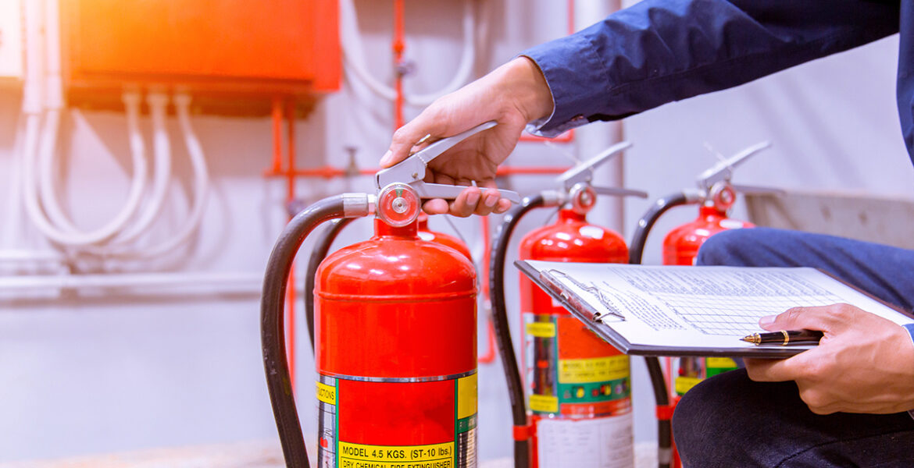
Fire educator qualifications
The US industry standard that outlines the recommended qualifications for fire safety educators is NFPA 1035: Standard for Professional Qualifications for Public Fire and Life Safety Educator, which includes the requirements for Fire and Life Safety Educator Levels I, II, and III; Public Information Officer; and Juvenile Firesetter Intervention Specialist Levels I and II.
Target audiences
According to the United States Fire Administration, the very young and the elderly are considered to be "at risk" populations. These groups represent approximately 33% of the population.

Slide 10
Global perspectives
Fire safety has been highlighted in relation to global supply chain management. Sedex, the Supplier Ethical Data Exchange, a collaborative platform for sharing ethical supply chain data, and Verité, Inc., a Massachusetts-based supply chain investigatory NGO, issued a briefing in August 2013 which highlighted the significance of this issue. The briefing referred to several major factory fires, including the 2012 Dhaka garment factory fire in the Tazreen Fashion factory and other examples of fires in Bangladesh, Pakistan and elsewhere, compared the incidence of fire safety issues in a manufacturing context, and highlighted the need for buyers, suppliers and local fire safety enforcement agencies all to take action to improve fire safety within the supply chains for ready-made garments and other products. The briefing recommended that buyers seek greater visibility of fire safety and other risks across the supply chain and identify opportunities to improve standards: "buyers can encourage change through more responsible and consistent practies".

Slide 11
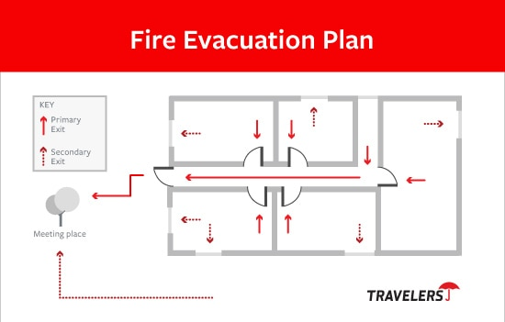
Fire safety plan
A fire safety plan is required by all North American national, state and provincial fire codes based on building use or occupancy types. Generally, the owner of the building is responsible for the preparation of a fire safety plan. Buildings with elaborate emergency systems may require the assistance of a fire protection consultant. After the plan has been prepared, it must be submitted to the Chief Fire Official or authority having jurisdiction for approval. Once approved, the owner is responsible for implementing the fire safety plan and training all staff in their duties. It is also the owner's responsibility to ensure that all visitors and staff are informed of what to do in case of fire. During a fire emergency, a copy of the approved fire safety plan must be available for the responding fire department's use.
In the United Kingdom, a fire safety plan is called a fire risk assessment.

Slide 12
Fire safety plan structure
Key contact information
Utility services (Including shut-off valves for water, gas and electric)
Access issues
Dangerous stored materials
Location of people with special needs
Connections to sprinkler system
Layout, drawing, and site plan of building
Maintenance schedules for life safety systems
Personnel training and fire drill procedure
Create assemble point/safe zone

Slide 13
Use of fire safety plans
Fire safety plans are a useful tool for fire fighters to have because they allow them to know critical information about a building that they may have to go into. Using this, fire fighters can locate and avoid potential dangers such as hazardous material (hazmat) storage areas and flammable chemicals. In addition to this, fire safety plans can also provide specialized information that, in the case of a hospital fire, can provide information about the location of things like the nuclear medicine ward. In addition to this, fire safety plans also greatly improve the safety of fire fighters. According to FEMA, 16 percent of all fire fighter deaths in 2002 occurred due to a structural collapse or because the fire fighter got lost. Fire safety plans can outline any possible structural hazards, as well as give the fire fighter knowledge of where he is in the building.

Slide 14
Fire safety plans in the fire code
In North America alone, there are around 8 million buildings that legally require a fire safety plan, be it due to provincial or state law. Not having a fire safety plan for buildings which fit the fire code occupancy type can result in a fine, and they are required for all buildings, such as commercial, industrial, assembly, etc.
Advances in fire safety planning
As previously stated, a copy of the approved fire safety plan shall be available for the responding fire department. This, however, is not always the case. Up until now, all fire plans were stored in paper form in the fire department. The problem with this is that sorting and storing these plans is a challenge, and it is difficult for people to update their fire plans. As a result, only half of the required buildings have fire plans, and of those, only around 10 percent are up-to-date. This problem has been solved through the introduction of digital fire plans. These fire plans are stored in a database and can be accessed wirelessly on site by firefighters and are much simpler for building owners to update.

Slide 15
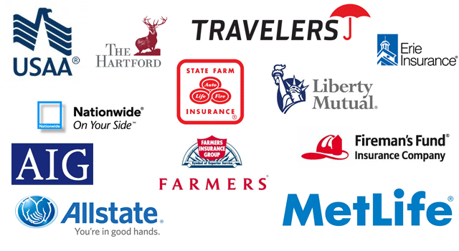
Insurance companies
Fire is one of the biggest threats to property with losses adding up to billions of dollars in damages every year. In 2019 alone, the total amount of property damage resulting from fire was $14.8 billion in the United States. Insurance companies in the United States are not only responsible for financially covering fire loss but are also responsible for managing risk associated with it. Most commercial insurance companies hire a risk control specialist whose primary job is to survey property to ensure compliance with NFPA standards, assess the current risk level of the property, and make recommendations to reduce the probability of fire loss. Careers in property risk management continue to grow and have been projected to grow 4 to 8% from 2018 to 2028 in the United States.

Slide 16
References
lifesafetydev. "Fire Safety". Life Safety Systems. Retrieved 2020-11-12.
"Planning , Drawing & Designing". matrixfireengineers.com. Retrieved 2020-11-12.
Paleja, Ameya (22 August 2022). "A fireproof wood achieves the highest class in burning test thanks to an invisible coating". interestingengineering.com. Retrieved 18 September 2022.
"An invisible coating to make wood 'fireproof'". Nanyang Technological University via techxplore.com. Retrieved 18 September 2022.
"Fire Safety". Fire Protection Specialists. Archived from the original on 19 January 2014. Retrieved 17 January 2014.
"Articles - Fire Code | Safety Media Inc". safetymedia.com. Retrieved 2020-11-12.
"NFPA eLearning On-line catalog". Archived from the original on 2009-01-16. Retrieved 2008-05-10.
"September 2011". Magazine. Retrieved 2020-11-06.
"Buy NFPA 1035: Standard on Fire and Life Safety Educator, Public Information Officer..." catalog.nfpa.org. Retrieved 2020-11-12.
BSI, Supplier Ethical Data Exchange (Sedex), accessed 28 May 2022
Sedex Information Exchange, Fire Safety briefing, August 2013, accessed 28 May 2022
Zia ur-Rehman, Declan Walsh and Salman Masood, More Than 300 Killed in Pakistani Factory Fires, New York Times, published 12 September 2012, accessed 28 May 2022
"Fire safety in the workplace". GOV.UK. Retrieved 21 August 2021.
American, Jerry, "Fire Safety Disaster", Canadian Healthcare Facilities Volume 28 Issue 3, ed Amie Silverwood. Spring 2008, 26.
Fire Fighter Fatalities in the U.S. in 2002. Fema, U.S. Department of Homeland Security, July 2003
"Canadian firm generates digital fire safety plans", Building Strategies, ed. Susan Maclean. Spring 2007, 14
"NFPA report - Fire loss in the United States". www.nfpa.org. Retrieved 2020-10-21.
"13-2099.02 - Risk Management Specialists". www.onetonline.org. Retrieved 2020-10-22.

